Slide 1

Lecture # 21

Slide 2
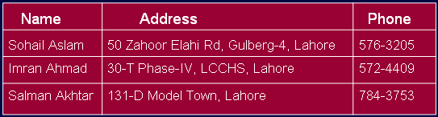
Tables: rows & columns of information
A table has several fields (types of information)
  A telephone book may have fields name, address, phone number
  A user account table may have fields user id, password, home folder

Slide 3
Tables: rows & columns of information
To find an entry in the table, you only need know the contents of one of the fields (not all of them).
This field is the key
  In a telephone book, the key is usually “name”
  In a user account table, the key is usually “user id”

Slide 4
Tables: rows & columns of information
Ideally, a key uniquely identifies an entry
  If the key is “name” and no two entries in the telephone book have the same name, the key uniquely identifies the entries

Slide 5
The Table ADT: operations
insert: given a key and an entry, inserts the entry into the table
find: given a key, finds the entry associated with the key
remove: given a key, finds the entry associated with the key, and removes it

Slide 6
How should we implement a table?
Our choice of representation for the Table ADT
depends on the answers to the following
How often are entries inserted and removed?
How many of the possible key values are likely to be used?
What is the likely pattern of searching for keys? E.g. Will most of the accesses be to just one or two key values?
Is the table small enough to fit into memory?
How long will the table exist?

Slide 7

TableNode: a key and its entry
For searching purposes, it is best to store the key and the entry separately (even though the key’s value may be inside the entry)

Slide 8
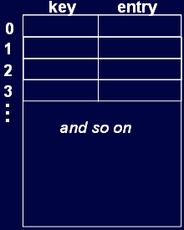
Implementation 1: unsorted sequential array
An array in which TableNodes are stored consecutively in any order
insert: add to back of array; (1 operation)
find: search through the keys one at a time, potentially all of the keys; (n operations)
remove: find + replace removed node with last node; (n operations)

Slide 9
Implementation 2: sorted sequential array
An array in which TableNodes are stored consecutively, sorted by key
insert: add in sorted order; (n)
find: binary search; (log n)
remove: find, remove node and shuffle down; (n)
We can use binary search because
the array elements are sorted

Slide 10
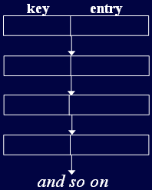
Implementation 3: linked list
TableNodes are again stored consecutively (unsorted or sorted)
insert: add to front; (1or n for a sorted list)
find: search through potentially all the keys, one at a time; (n for unsorted or for a sorted list
remove: find, remove using pointer alterations; (n)

Slide 11
Implementation 4: Skip List
Overcome basic limitations of previous lists
  As in those Search and update required linear time
Fast Searching of Sorted Chain
Provide alternative to BST (binary search trees) and related tree structures. Balancing can be expensive.
Relatively recent data structure: Bill Pugh proposed it in 1990.

Slide 12

Skip List Representation
Can do better than n comparisons to find element in chain of length n

Slide 13
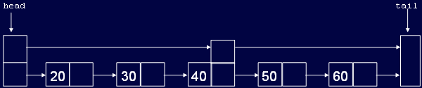
Skip List Representation
Example: n/2 + 1 if we keep pointer to middle element

Slide 14
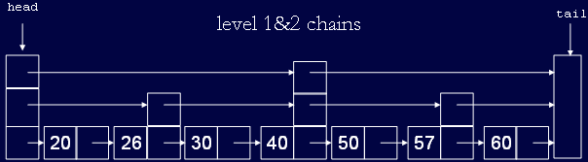
Higher Level Chains
For general n, level 0 chain includes all elements
level 1 every other element, level 2 chain every fourth, etc.
level i, every 2^{i} th element

Slide 15
Higher Level Chains
Skip list contains a hierarchy of chains
In general level i contains a subset of elements in level i-1

Slide 16
Skip List: formally
A skip list for a set S of distinct (key, element) items is a series of lists S₀, S₁ , … , S_{h} such that
  Each list S_{i} contains the special keys +∞ and -∞
  List S₀ contains the keys of S in nondecreasing order
  Each list is a subsequence of the previous one, i.e.,
  S₀ ⊇ S₁ ⊇ … ⊇ S_{h}
  List S_{h} contains only the two special keys

Slide 17
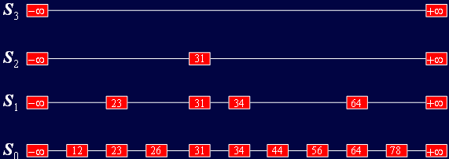
Skip List: formally

Slide 18
Skip List: Search
  We search for a key x as follows:
  We start at the first position of the top list
  At the current position p, we compare x with y ← key(after(p))
  x = y: we return element(after(p))
  x > y: we “scan forward”
  x < y: we “drop down”
  If we try to drop down past the bottom list, we return NO_SUCH_KEY

Slide 19
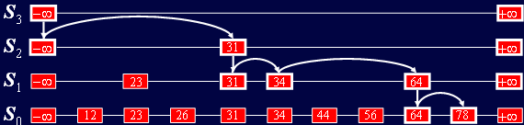
Skip List: Search
Example: search for 78

Slide 20
Skip List: Insertion
To insert an item (key, entry) into a skip list, we use a randomized algorithm:
  We repeatedly toss a coin until we get tails, and we denote with i the number of times the coin came up heads
  If i ≥ h, we add to the skip list new lists S_{h+1}, … …., S_{i+1}, each containing only the two special keys

Slide 21
Skip List: Insertion
To insert an item (key, entry) into a skip list, we use a randomized algorithm: (Cont)
  We search for x in the skip list and find the positions p₀ , p₁ , …, p_{i} of the items with largest key less than x in each list S₀, S₁ , … , S_{i}
  For j ← 0, …, i, we insert item (key, entry) into list S_{j} after position p_{j}

Slide 22
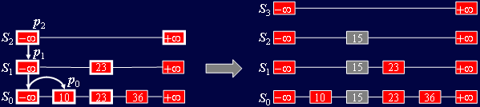
Skip List: Insertion
Example: insert key 15, with i = 2

Slide 23
Randomized Algorithms
A randomized algorithm performs coin tosses (i.e., uses random bits) to control its execution
It contains statements of the type
    b ← random()
    if b <= 0.5 // head
    do A …
    else // tail
    do B …
Its running time depends on the outcomes of the coin tosses, i.e, head or tail

Slide 24
Skip List: Deletion
To remove an item with key x from a skip list, we proceed as follows:
  We search for x in the skip list and find the positions p₀ , p₁ , …, p_{i} of the items with key x, where position p_{j} is in list S_{j}
  We remove positions p₀ , p₁ , …, p_{i} from the lists S₀, S₁ , … , S_{i}
  We remove all but one list containing only the two special keys

Slide 25
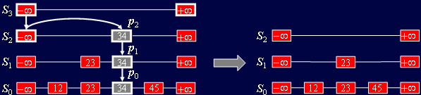
Skip List: Deletion
Example: remove key 34

Slide 26
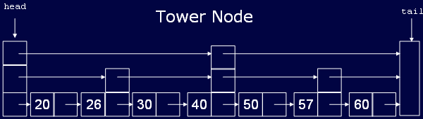
Implementation: TowerNode
TowerNode will have array of next pointers.
Actual number of next pointers will be decided by the random procedure.
Define MAXLEVEL as an upper limit on number of levels in a node.

Slide 27
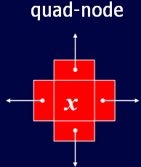
Implementation: QuadNode
A quad-node stores:
  item
  link to the node before
  link to the node after
  link to the node below
  link to the node above
This will require copying the key (item) at different levels

Slide 28
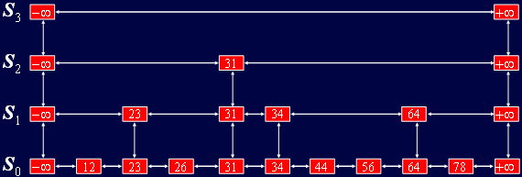
Skip Lists with Quad Nodes

Slide 29
Performance of Skip Lists
In a skip list with n items
  The expected space used is proportional to n.
  The expected search, insertion and deletion time is proportional to log n.
Skip lists are fast and simple to implement in practice

Slide 30
Thanks …

